Slide 1
Paraphrasing & PRINT SOURCES
5th Grade Research Project

Slide 2
Getting things rolling…
Question I
What did you do after school yesterday?
Question II
Where would you like to go on vacation, and why?

Slide 3
Paraphrasing… what is it?
Paraphrasing is putting an author’s words into your own words
The meaning of the passage CANNOT change, if so, you are NOT paraphrasing
Paraphrasing isn’t a summary, because it usually focuses on a single main idea

Slide 4
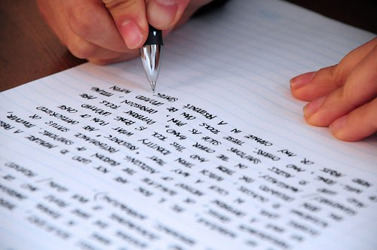
Tricks to paraphrasing: the four R’s
Reword – replace words and phrases with synonyms whenever you can.
Rearrange – rearrange words within sentences to make new sentences. You can even rearrange the ideas presented within the paragraph.
Realize that some words and phrases cannot be changed – names, dates, titles etc. cannot be replaced, but you can present them differently in your paraphrase.
Recheck – make sure that your paraphrase conveys the same meaning as the original text.

Slide 5
A step by step guide
Read the passage thoroughly
Read the passage again
a. Keep rereading the passage until you understand its full meaning
Identify the key points of the passage
Set the passage aside
In your own words, restate the meaning of the passage
Look at the original passage and compare

Slide 6
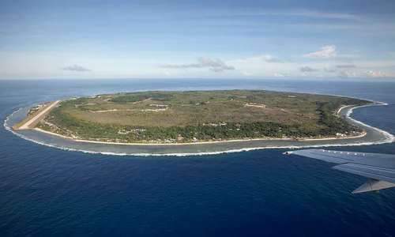
Example
Original
“At just 8.5 square miles, the Pacific island country of Nauru is one of the smallest countries in the world. The island was once rich in phosphate, but most of the resource has been mined leaving damage to the environment behind. Nauru has a population of about 10,000 people.”
Paraphrase
Nauru is a Pacific island country that is only 8.5 square miles in area. It is one of the smallest countries on the planet and only about 10,000 people live there. Nauru has mined its once plentiful supplies of phosphate. This has damaged the environment on the island.

Slide 7
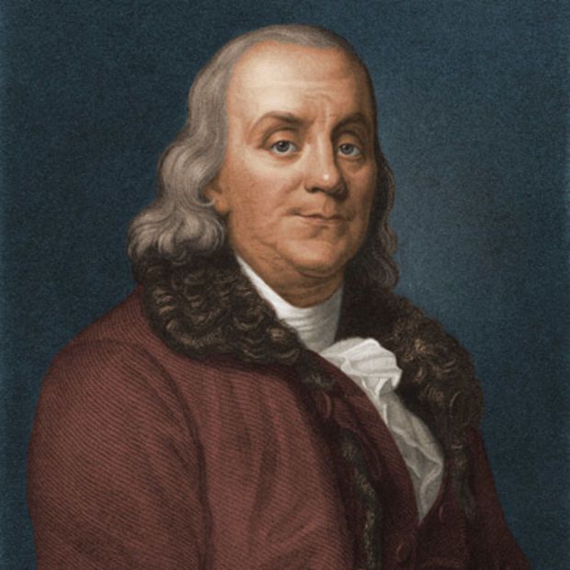
Another Example
Original
“Although he was born in a poor family, Benjamin Franklin made a fortune as a printer in Philadelphia. By the age of 42, Franklin was one of the richest men in the colonies. He chose to retire from active business and become a “gentleman.” He began to pursue “philosophical studies and amusements.” He was especially curious about electricity, and his experiments made him famous.”
Paraphrase
Benjamin Franklin is well-known as both a businessman and a scientist. Franklin’s successful printing business in Philadelphia led him to become one of the most wealthy men in the area. When he was only 42, he decided to retire from business and spend more time doing things he loved, such as electrical experiments and philosophical studies.

Slide 8
Let’s do it! Paraphrasing as a class
Original
“President Jefferson believed that the future of America lay in the West. Now that so much new land belonged to the United States, he wanted to have it explored. He hoped to find a waterway across North America to the Pacific Ocean.”
Our version:
Remember the steps…
Read the passage thoroughly
Read the passage again
a. Keep rereading the passage until you understand its full meaning
Identify the key points of the passage
Set the passage aside
In your own words, restate the meaning of the passage
Look at the original passage and compare

Slide 9
One more time…
Original
“In 1849, the majority of people in the United States lived east of the Mississippi River. The states with the most people were New York, Pennsylvania, Ohio, and Virginia. After gold was discovered, people headed west hoping to get rich. The rumor was that gold was easy to find in California, but it might not last forever.”
Our version:
Remember the steps…
Read the passage thoroughly
Read the passage again
a. Keep rereading the passage until you understand its full meaning
Identify the key points of the passage
Set the passage aside
In your own words, restate the meaning of the passage
Look at the original passage and compare

Slide 10
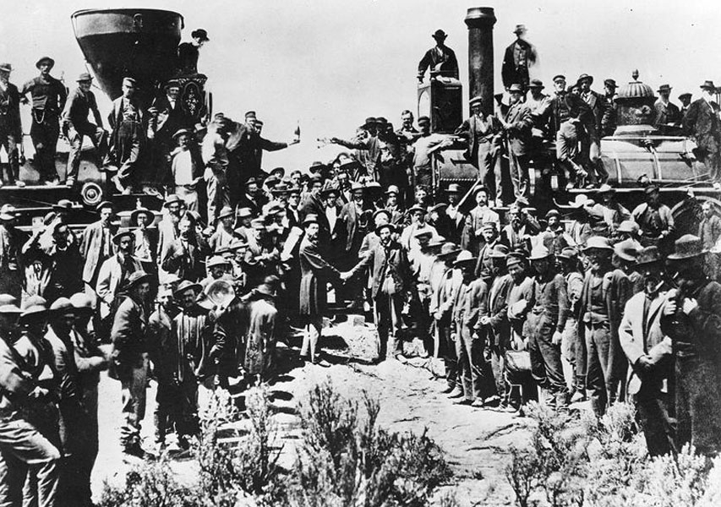
Now it’s your turn!
Original
“While the Union Pacific crews were making a mile a day out on the Nebraska prairie in the fall of 1866, Central Pacific laborers were chipping away at the solid rock walls of the Sierra Nevada. As far as the Big Four were concerned, losing ground to the Union Pacific meant losing money.”
Remember the steps
Read the passage thoroughly
Read the passage again
a. Keep rereading the passage until you understand its full meaning
Identify the key points of the passage
Set the passage aside
In your own words, restate the meaning of the passage
Look at the original passage and compare

